Slide 1
Aung Myin Kyaw (Max) weekly Research Progress Report
Date : 18/08/2018 to 25/08/2018
Scope of the work:
Printing of the data to csv file and understanding the values

Slide 2
Research Progress in last week
This is week I was able to collect data into the csv file (the file is attached as ‘test1.csv). The code I used to collect data is attached in the following slide.
However, the data collected does not tally with the data I downloaded from Thorlabs which is attached as ‘testthorlabs.csv’. Thus, for the coming week I will be examining the representation of the values that are collected.

Slide 3
CCS100.startScan();
CCS100.getScanData(Data);
Console.WriteLine(Data.Length);
StreamWriter sw = new StreamWriter(@"C:\Users\AungMyin\Desktop\School\FYP\Final-Year-Project\test1.csv", true);
for (int i = 0; i < Data.Length; i++) {
{
sw.WriteLine(Data[i].ToString());
//sw.Write("\n");
}
}
sw.Write("\r\n");
sw.Flush();
sw.Close();
By using the function that I presented above, I am able to save the scan data by CS100 to excel file.

Slide 4
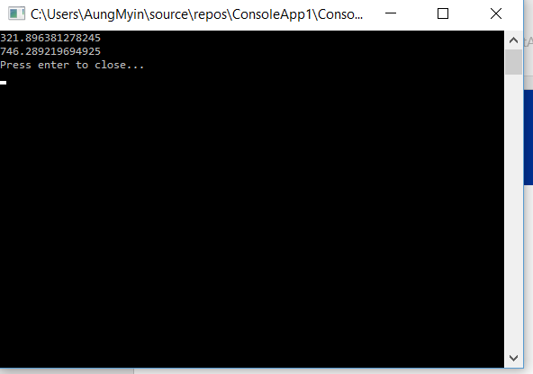
Research Progress in last week
In addition, from this experiment I am able to find out that minimum (321.896381278245) and maximum (746.289219694925) wavelength that can be measured using my wavelength. The wavelengths are the same when I compared with the maximum and minimum wavelength that measured using Thorlabs.

Slide 5
Research Plan for next week
Identifying the values that are being save to the csv file. Check whether any calibration is needed to collect the data correctly.
Once the values are identify, try to read those values and plot a graph in the program.
.

Slide 6
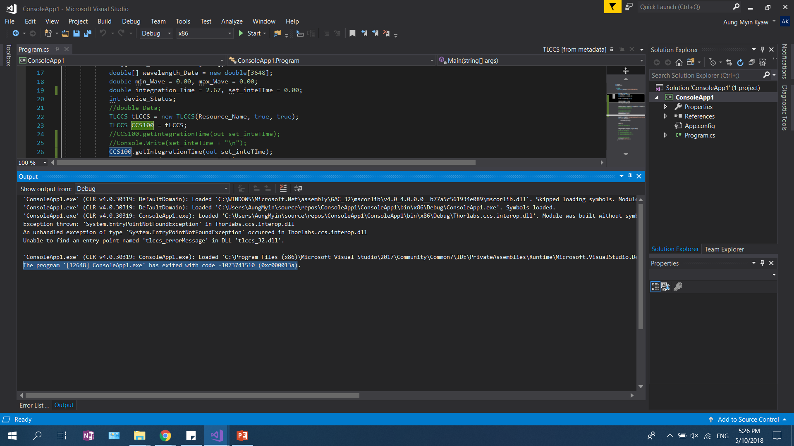
Research Plan for next week
Identifying the values that are being save to the csv file. Check whether any calibration is needed to collect the data correctly.
Once the values are identify, try to read those values and plot a graph in the program.
.

